Slide 1




LUMORA
Adaptive Cognitive Load and Style Prediction System for Online Learning Using Behavioral Patterns
STUDENT ID
NAME
MODULE
IT22281364
IT22089786
IT22166074
IT22055712
Imesh L A R
Subasinghe M.H.R.I
Jayasinghe J. M. S. N
Dilshan W.G.W
Cognitive Style and Learner Profile Detection
Real-Time Cognitive Load Prediction
Cognitive-Adaptive Content Personalization Engine (CACPE)
Adaptive Assessment and Educator Analytics
Supervisor: Dr. Kalpani Manathunge
Co-Supervisor: Mr. Jeewaka Perera
SUPERVISION
R26-SE-004

Slide 2











Lumora : Adaptive Cognitive Load and Style Prediction System for Online Learning Using Behavioral Patterns
PP2 Comments and Actions Taken
IT22166074
Overall good. Improve the time management
Improved time management and streamlined the presentation flow.
Conducted component testing and validated system functionality through UAT and expert evaluations.
All the component should be properly tested. Overall Okay
IT22281364
IT22055712
Continued system improvements and refined the implemented components.
Overall Good
Need to clarify the flow and process and demonstrate a proper understanding of the component. Test should be done for the final
Clarified the overall system workflow and prepared detailed explanations. Performed UAT and model evaluation.
IT22089786
R26-SE-004

Slide 3







Lumora : Adaptive Cognitive Load and Style Prediction System for Online Learning Using Behavioral Patterns
Problem in Brief and Design Excellence
Problem in Brief
Feature / Component
Traditional E-learning
Our System
One-Size-Fits-All Learning
Ignores individual learning styles.
Cognitive style detection
No
Yes
Cognitive load detection
No
Yes
High Cognitive Load
Complex content makes learning difficult.
Content conversion
Limited
Yes
Resource upload section
Basic
Yes
Lack of Adaptive Content
Content fails to adapt to learners’ cognitive needs.
Explainable AI + recommendation system
No
Yes
R26-SE-004

Slide 4
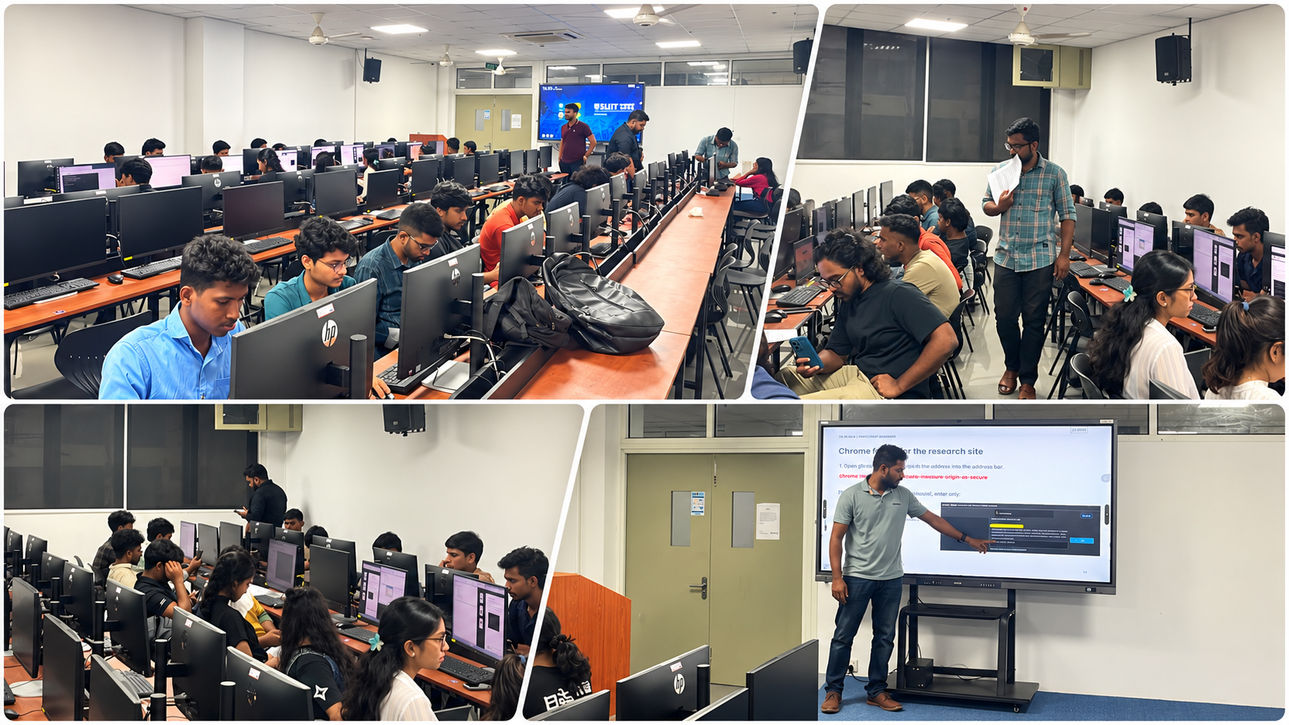
User Testing

Slide 5

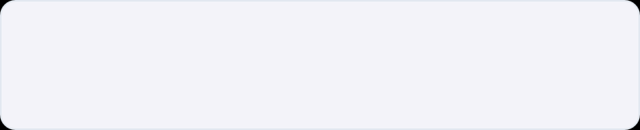
Lumora : Adaptive Cognitive Load and Style Prediction System for Online Learning Using Behavioral Patterns
Cognitive Style and Learner Profile Detection
Learner Profile Detection
Uses the ASSIST questionnaire to categorize learners into Surface, Deep, and Strategic learners.
Visual Verbal Cognitive Style Detection
Uses an SVM model to classify learners into Visual or Verbal cognitive styles.
Analytic Wholistic Cognitive Style Detection
Uses the AHS questionnaire to categorize learners into Analytic or Wholistic styles
IT22281364 | Imesh L A R | R26-SE-004

Slide 6
Evaluation Results
▥
Cognitive Load Prediction: User Acceptance Testing and Model Performance
Evaluation - User acceptance testing
Evaluation - Model performance
37 feedback submissions rated 3 aspects of the cognitive Style experience on a 1–5 scale.
Accuracy comparison across four candidate machine-learning models.
5
100
3.97
3.59
3.86
72.5%
77.5%
4
80
60.0%
65.3%
3
60
2
40
1
20
0
0
Cognitive Style Match
Learning Profile Match
Content Presentation
Decision Tree
Random Forest
Random
Forest
Support Vector Machine
✓
Positive UAT ratings: 75.7% · 67.6% · 70.3%
✓
Support Vector Machine: 77.5% accuracy

Slide 7

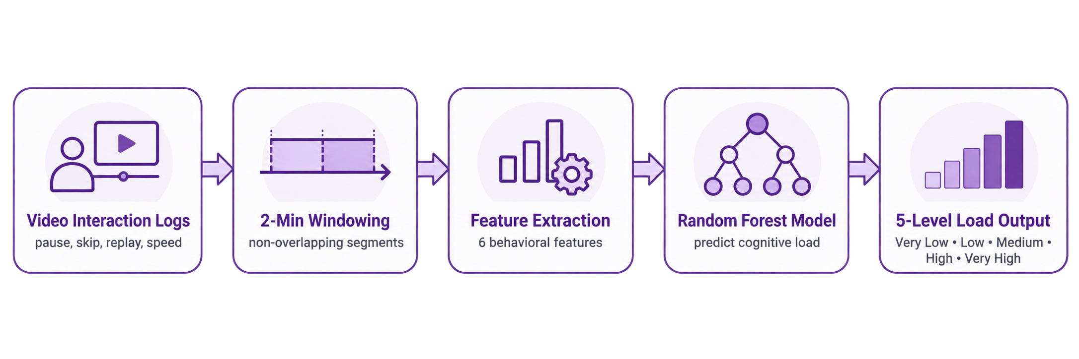




Lumora : Adaptive Cognitive Load and Style Prediction System for Online Learning Using Behavioral Patterns
Real-Time Cognitive Load Prediction
Monitors learners' video interaction patterns to predict cognitive load levels and support timely learning adaptation.
Behavioral Tracking
Feature Extraction
Captures pauses, rewatches, forward skips, playback speed changes and idle time.
Extracts six behavioral features from non-overlapping two-minute learning windows.
Load Classification
Adaptive Learning Support
Uses Random Forest to predict five cognitive load levels from learner behavior.
Provides cognitive load predictions for personalized learning and adaptive assessments.
IT22089786 | Subasinghe M.H.R.I| R26-SE-004

Slide 8
Evaluation Results
▥
Cognitive Load Prediction: User Acceptance Testing and Model Performance
Evaluation - User acceptance testing
Evaluation - Model performance
37 feedback submissions rated 3 aspects of the cognitive load experience on a 1–5 scale.
Accuracy comparison across four candidate machine-learning models.
5
100
3.73
3.84
3.84
79.52%
75.77%
4
80
66.89%
67.58%
3
60
2
40
1
20
0
0
Load prediction
match
Adapted explanation
clarity
Content amount
suitability
Logistic
Regression
Decision
Tree
Random
Forest
XGBoost
✓
Positive UAT ratings: 73.0% · 70.3% · 64.9%
✓
Random Forest: 79.52% accuracy

Slide 9

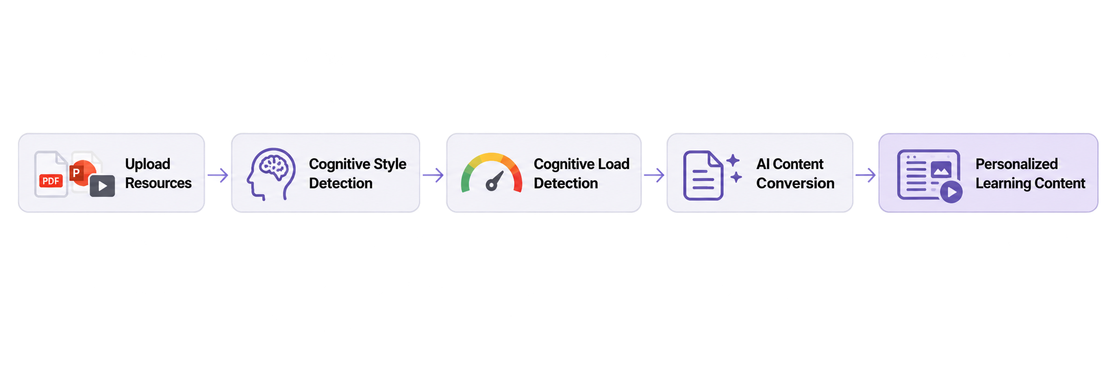
Lumora : Adaptive Cognitive Load and Style Prediction System for Online Learning Using Behavioral Patterns
Cognitive-Adaptive Content Personalization Engine (CACPE)
AI-powered content adaptation based on learners’ cognitive styles and cognitive load.
Cognitive Style Adaptation
Cognitive Load Optimization
Personalizes learning content based on each learner's cognitive style.
Simplifies complex information to reduce cognitive overload.
Multi-Format Content Input
GPT-Powered Conversion
Processes uploaded PDF, PPT and video learning resources.
Transforms learning materials into personalized, easier-to-understand content.
IT22166074 | Jayasinghe J. M. S. N| R26-SE-004

Slide 10
▥
Evaluation Results
Content Conversion: User Acceptance Testing and Expert Evaluation
Evaluation – User Acceptance Testing
Evaluation – Expert Evaluation
36 valid submissions • 3 learner-experience questions
5 expert evaluators • 12 questions, grouped into 4 themes
5
5
4.60
4.70
4.65
4.60
4.03
3.83
3.81
4
4
3
3
2
2
1
1
0
0
Language clarity
Understanding main ideas
Learning-aid satisfaction
Resource
upload
Knowledge
extraction
Content
adaptation
Teaching
suitability
77.8% positive
72.2% positive
72.2% positive
100.0% positive
96.7% positive
100.0% positive
100.0% positive
✓
Positive UAT ratings: 77.8% • 72.2% • 72.2%
✓
Expert ratings: 4.67/5 mean • 98.3% positive
Positive = Agree + Strongly Agree. Expert scores are mean responses to grouped survey items; not independent algorithm accuracy.

Slide 11

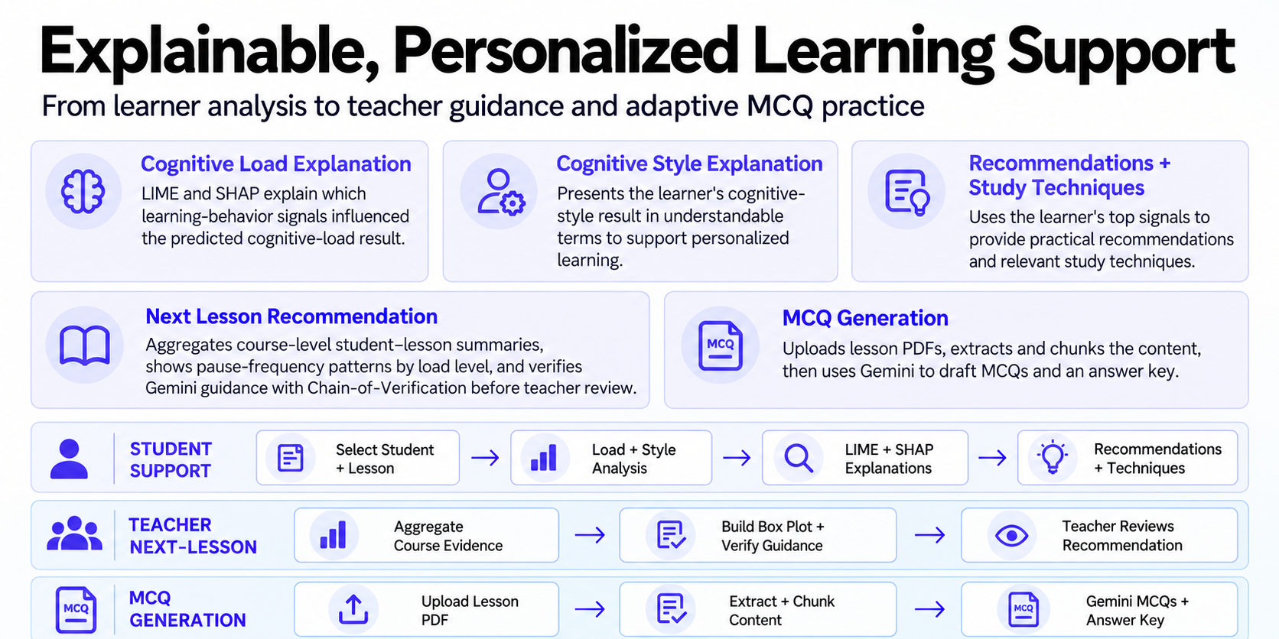







Lumora : Adaptive Cognitive Load and Style Prediction System for Online Learning Using Behavioral Patterns
Explainable, Personalized Learning Support
From leaner analysis to teacher guidance and adaptive MCQ practice
Behavioral Tracking
Cognitive Style Prediction
Captures gaze, cursor movements and learning interaction patterns.
Uses an SVM model to classify learners into Visual or Verbal cognitive styles.
Learner Profile Generation
Adaptive Learning Support
Maintains individual cognitive style and behavioral characteristics.
Provides learner profile insights to support personalized content delivery.
Survey +
Camera + Goal
Plan
Practice
Recalibrate
IT22055712 | Dilshan W.G.W| R26-SE-004

Slide 12
Evaluation Results
Comparison of Baseline vs. Adaptive across Expert Review (MCQs) and Lecturer Guidance
▤
Evaluation / MCQ expert review
▤
Evaluation / Lecturer guidance
5 lecturers reviewed one baseline/adaptive lesson-pack pair each,
with 10 questions per set.
5 lecturers reviewed 3 paired cases each. Mean ratings on a 1–5 scale,
with 15 ratings per method.
5
4.34
4.20
5
4.20
4.20
4.40
4.60
4.27
4.16
4.16
4
4
3.07
2.80
2.93
2.93
3.07
3
2.30
2.56
2.22
2.20
3
2
2
1
1
0
0
Wording
manageability
Difficulty
suitability
Directness
Overall
suitability
Clarity
Evidence
relevance
Recommendation
usefulness
Technique
suitability
Overall
usefulness
Baseline
Adaptive
Baseline
Adaptive
✓
5/5 lecturers preferred the adaptive MCQs
✓
15/15 paired cases preferred adaptive guidance
Answer-key checks: baseline 50 Yes. Adaptive 49 Yes, 1 Uncertain.

Slide 13
Commercialization, Limitations & Future Improvements
Commercialization Path
Four Key Limitations
Free launch
Engagement
01
Need more dataset .
01
02
Open access for early practice and adoption.
Students and educators experience adaptive learning.
Interaction signals estimate cognitive load indirectly, not mental state directly.
02
03
AI-generated explanations and recommendations still require reliability checks.
04
Findings from limited learner groups may not generalize to all contexts.
03
Revenue scale
04
Paid courses
Future Improvements
Educators introduce premium learning courses.
Revenue shared through course sales with educators.
• Expand testing across learner groups and courses.
• Improve activity-window reliability and load prediction.
• Refine content length, difficulty and educator recommendations.

Slide 14


